Slide 1
Unit 2
World Wide Web

Slide 2
Introduction to WWW
World Wide Web, which is also known as a Web, is a collection of websites or web pages stored in web servers and connected to local computers through the internet.
These websites contain text pages, digital images, audios, videos, etc. Users can access the content of these sites from any part of the world over the internet using their devices such as computers, laptops, cell phones, etc.

Slide 3
The WWW, along with internet, enables the retrieval and display of text and media to your device.
The building blocks of the Web are web pages which are formatted in HTML and connected by links called "hypertext" or hyperlinks and accessed by HTTP.
A web page is given an online address called a Uniform Resource Locator (URL). A particular collection of web pages that belong to a specific URL is called a website, e.g., www.facebook.com, www.google.com, etc. So, the World Wide Web is like a huge electronic book whose pages are stored on multiple servers across the world.

Slide 4
Difference between World Wide Web and Internet
Some people use the terms 'internet' and 'World Wide Web' interchangeably. They think they are the same thing, but it is not so. Internet is entirely different from WWW. It is a worldwide network of devices like computers, laptops, tablets, etc. It enables users to send emails to other users and chat with them online. For example, when you send an email or chatting with someone online, you are using the internet.

Slide 5
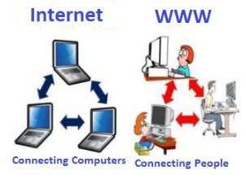

Slide 6
But, when you have opened a website like google.com for information, you are using the World Wide Web; a network of servers over the internet. You request a webpage from your computer using a browser, and the server renders that page to your browser. Your computer is called a client who runs a program (web browser), and asks the other computer (server) for the information it needs.

Slide 7
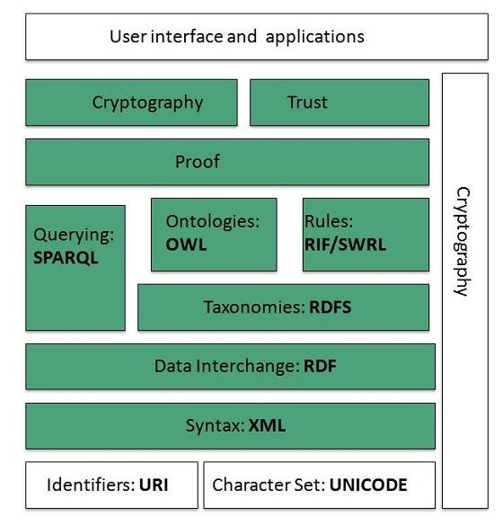
WWW Architecture

Slide 8
Identifiers and Character Set :
Uniform Resource Identifier (URI) is used to uniquely identify resources on the web and UNICODE makes it possible to built web pages that can be read and write in human languages.

Slide 9
Syntax :
XML (Extensible Markup Language) helps to define common syntax in semantic web.
Data Interchange:
Resource Description Framework (RDF) framework helps in defining core representation of data for web. RDF represents data about resource in graph form.

Slide 10
Taxonomies:
RDF Schema (RDFS) allows more standardized description of taxonomies.

Slide 11
Ontologies :
Web Ontology Language (OWL) offers more constructs over RDFS. It comes in following three versions:
OWL Lite for taxonomies and simple constraints.
OWL DL for full description logic support.
OWL for more syntactic freedom of RDF

Slide 12
Rules :
RIF and SWRL offers rules beyond the constructs that are available from RDFs and OWL. Simple Protocol and RDF Query Language (SPARQL) is SQL like language used for querying RDF data and OWL Ontologies.

Slide 13
Proof :
All semantic and rules that are executed at layers below Proof and their result will be used to prove deductions.
Cryptography :
Cryptography means such as digital signature for verification of the origin of sources is used.

Slide 14
User Interface and Applications
On the top of layer User interface and Applications layer is built for user interaction.

Slide 15
Introduction to Internet Protocols
The Internet Protocol (IP) is the method or Protocol by which data is sent from one computer to another on the Internet. Each computer (known as a host) on the Internet has at least one IP address that uniquely identifies it from all other computers on the Internet.

Slide 16
TCP
TCP is a connection oriented protocol and offers end-to-end packet delivery. It acts as back bone for connection.
While TCP is used to connect network devices to the internet, it can also be used as a communication protocol for a private intranet or extranet.

Slide 17
Features of TCP
Transmission Control Protocol (TCP) corresponds to the Transport Layer of OSI Model.
TCP is a reliable and connection oriented protocol.
TCP offers:
Stream Data Transfer.
Reliability.
Efficient Flow Control
Full-duplex operation.
Multiplexing.

Slide 18
TCP offers connection oriented end-to-end packet delivery.
TCP ensures reliability by sequencing bytes with a forwarding acknowledgement number that indicates to the destination the next byte the source expect to receive.
It retransmits the bytes not acknowledged with in specified time period.

Slide 19
IP
The Internet Protocol (IP) is a protocol, or set of rules, for routing and addressing packets of data so that they can travel across networks and arrive at the correct destination.
Data traversing the Internet is divided into smaller pieces, called packets. IP information is attached to each packet, and this information helps routers to send packets to the right place.

Slide 20
Every device or domain that connects to the Internet is assigned an IP address, and as packets are directed to the IP address attached to them, data arrives where it is needed.

Slide 21
UDP
UDP is connectionless and unreliable protocol. It doesn’t require making a connection with the host to exchange data. Since UDP is unreliable protocol, there is no mechanism for ensuring that data sent is received.
UDP transmits the data in form of a datagram.

Slide 22
UDP (User Datagram Protocol) is a communications protocol that is primarily used for establishing low-latency and loss-tolerating connections between applications on the internet. It speeds up transmissions by enabling the transfer of data before an agreement is provided by the receiving party.

Slide 23
FTP
FTP is used to copy files from one host to another.
FTP is a widely used network protocol for transferring files between computers over a TCP/IP-based network, such as the Internet.
FTP lets people and applications exchange and share data within their offices and across the Internet.

Slide 24
FTP was one of the first technologies developed to solve this common need, and it remains, with several generations of enhancements, the second most popular protocol used today (after HTTP or the "World Wide Web").

Slide 25
HTTP
HTTP is a communication protocol. It defines mechanism for communication between browser and the web server. It is also called request and response protocol because the communication between browser and server takes place in request and response pairs.

Slide 26
HTTP Request
HTTP request comprises of lines which contains:
Request line
Header Fields
Message body
Key Points
The first line i.e. the Request line specifies the request method i.e. Get or Post.
The second line specifies the header which indicates the domain name of the server from where index.htm is retrieved.

Slide 27
HTTP Response
Like HTTP request, HTTP response also has certain structure.
HTTP response contains:
- Status line
- Headers
- Message body

Slide 28
ISP: Internet Service Provider
ISP stands for Internet Service Provider. It is a company that provides access to the internet and similar services such as Website designing and virtual hosting.
For example, when you connect to the Internet, the connection between your Internet-enabled device and the internet is executed through a specific transmission technology that involves the transfer of information packets through an Internet Protocol route.

Slide 29
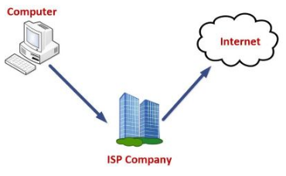

Slide 30
Data is transmitted through different technologies, including cable modem, dial-up, DSL, high speed interconnects. Accordingly, based on the method of data transmission.

Slide 31
ISP Types
ISPs can broadly be classified into six categories

Slide 32
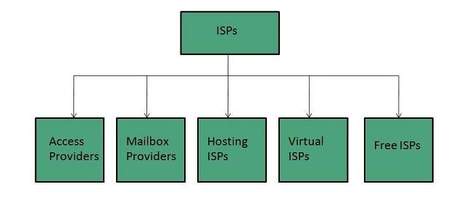

Slide 33
Access providers
They provide access to internet through telephone lines, cable wi-fi or fiber optics.
Mailbox Provider
Such providers offer mailbox hosting services.
Hosting ISPs
Hosting ISPs offers e-mail, and other web hosting services such as virtual machines, clouds etc.

Slide 34
Virtual ISPs
Such ISPs offer internet access via other ISP services.
Free ISPs
Free ISPs do not charge for internet services.

Slide 35
According to the method of data transmission, the Internet access that ISPs provide to users can be divided into several types, the most popular of which are :
Dial-up Internet Connection
DSL
Cable Internet
Wireless Broadband
ISDN
Ethernet

Slide 36
DSL
DSL, short for 'digital subscriber loop' or 'digital subscriber line', is an advanced version of the dial-up Internet access method. In contrast to dial-up, DSL uses high frequency to execute a connection over the local telephone network. This allows the Internet and the phone connections to be run on one and the same telephone line.

Slide 37
The digital subscriber line technology ensures an Asymmetric Digital Subscriber Line (ADSL), where the upload speed is lower than the download speed, and a Symmetric Digital Subscriber Line (SDSL), offering equal upload and download speeds. Of them both, ADSL is much more popular and is even known as just DSL to users.

Slide 38
Wireless Broadband (WiBB)
This is a new-generation broadband Internet access technology, allowing the delivery of high-speed wireless Internet within a large area. Wireless broadband ISPs (WISPs) ensure connection speeds that come close to the wired broadband speeds provided by DSL and cable ISPs.

Slide 39
To get wireless broadband you need to place a specific dish on your house roof or apartment balcony and point it to the transmitter of your WISP. This type of Internet access is used as an alternative to the wired broadband connection in remote areas.

Slide 40
ISDN
ISDN is acronym of Integrated Services Digital Network.
It establishes the connection using the phone lines which carry digital signals instead of analog signals.
ISDN represents a telephone system network, integrating a high-quality digital transmission of voice and data over the ordinary phone line.

Slide 41
Ensuring a much better data transmission over the phone line than an analog line could allow, the ISDN offers a fast upstream/downstream Internet connection speed of 128 kbit/s. This speed level can be considered as a broadband speed as opposed to the narrowband speed of standard analog 56k telephone lines.

Slide 42
Ethernet
Another Internet access type worth mentioning is Ethernet - the most widespread wired LAN (local area network) technology, also used in wireless LANs.
The Ethernet technology may ensure various speed levels and can thus be divided into several types: regular Ethernet, providing transmission speeds of up to 10 mbits/s, fast Ethernet, offering up to 100 mbits/s, gigabit Ethernet, supporting 1 gbit/s and 10-Gbit Ethernet, coming at up to 10 gbits/s.

Slide 43
Application of Internet
Search Engine
Web server
News Group

Slide 44
Search Engine
Search Engine refers to a huge database of internet resources such as web pages, newsgroups, programs, images etc. It helps to locate information on World Wide Web.
A search engine is software accessed on the Internet that searches a database of information according to the user's query. The engine provides a list of results that best match what the user is trying to find.
User can search for any information by passing query in form of keywords or phrase. It then searches for relevant information in its database and return to the user.

Slide 45
Search Engine Components
Generally there are three basic components of a search engine as listed below:
Web Crawler
Database
Search Interfaces

Slide 46
Web crawler
It is also known as spider or bots. It is a software component that traverses the web to gather information.
Database
All the information on the web is stored in database. It consists of huge web resources.
Search Interfaces
This component is an interface between user and the database. It helps the user to search through the database.

Slide 47
Example :
Google
It was originally called BackRub. It is the most popular search engine globally.
Bing
It was launched in 2009 by Microsoft. It is the latest web-based search engine that also delivers Yahoo’s results.

Slide 48
Web Server
Web server is a computer where the web content is stored. Basically web server is used to host the web sites but there exists other web servers also such as gaming, storage, FTP, email etc.

Slide 49
Web Server Working :
Web server respond to the client request in either of the following two ways:
Sending the file to the client associated with the requested URL.
Generating response by invoking a script and communicating with database

Slide 50
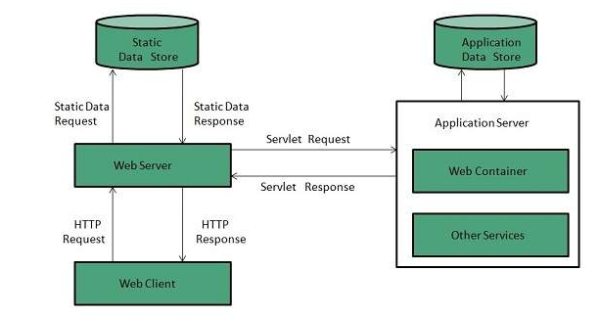

Slide 51
When client sends request for a web page, the web server search for the requested page if requested page is found then it will send it to client with an HTTP response.
If the requested web page is not found, web server will the send an HTTP response:Error 404 Not found.
If client has requested for some other resources then the web server will contact to the application server and data store to construct the HTTP response.

Slide 52
Examples :
Apache HTTP Server This is the most popular web server in the world developed by the Apache Software Foundation. Apache web server is an open source software and can be installed on almost all operating systems including Linux, UNIX, Windows, FreeBSD, Mac OS X and more. About 60% of the web server machines run the Apache Web Server.
Internet Information Services (IIS) The Internet Information Server (IIS) is a high performance Web Server from Microsoft.

Slide 53
News Group
Newsgroups are a worldwide system for the electronic exchange of news and views on a particular topic.
Its is also refer to as Usenet news.
There exist a number of newsgroups distributed all around the world. These are identified using a hierarchical naming system in which each newsgroup is assigned a unique name that consists of alphabetic strings separated by periods.

Slide 54
The leftmost portion of the name represents the top-level category of the newsgroup followed by subtopic. The subtopic can further be subdivided and subdivided even further (if needed).
For example, the newsgroup comp.lang.C++ contains discussion on C++ language. The leftmost part comp classifies the newsgroup as one that contains discussion of computer related topics. The second part identifies one of the subtopic lang that related to computer languages. The third part identifirs one of the computer languages, in this case C++.

Slide 55
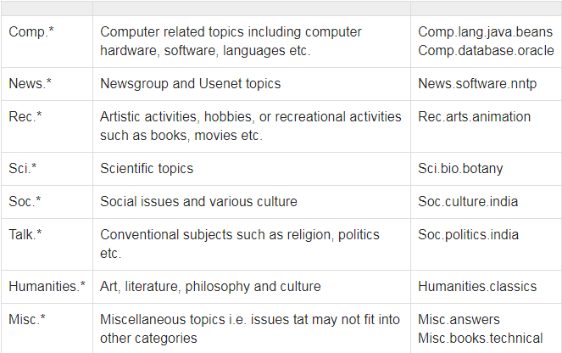

Slide 56
E-mail
E-mail is defined as the transmission of messages on the Internet. It is one of the most commonly used features over communications networks that may contain text, files, images, or other attachments. Generally, it is information that is stored on a computer sent through a network to a specified individual or group of individuals.

Slide 57
E-Mail Address
Each user of email is assigned a unique name for his email account. This name is known as E-mail address. Different users can send and receive messages according to the e-mail address.
E-mail is generally of the form username@domainname. For example, webmaster@tutorialspoint.com is an e-mail address where webmaster is username and tutorialspoint.com is domain name.

Slide 58
The username and the domain name are separated by @ (at) symbol.
E-mail addresses are not case sensitive.
Spaces are not allowed in e-mail address.

Slide 59
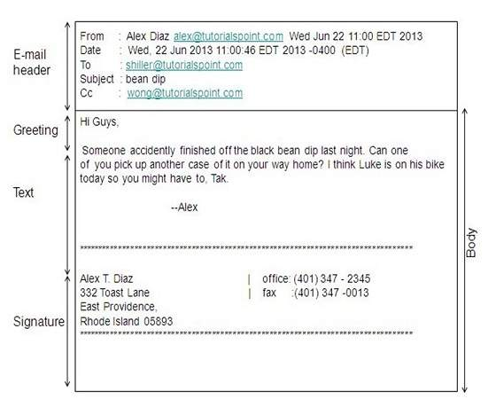

Slide 60
E-mail Header
The first five lines of an E-mail message is called E-mail header. The header part comprises of following fields:
From
Date
To
Subject
CC
BCC

Slide 61
From
The From field indicates the sender’s address i.e. who sent the e-mail.
Date
The Date field indicates the date when the e-mail was sent.
To
The To field indicates the recipient’s address i.e. to whom the e-mail is sent.
Subject
The Subject field indicates the purpose of e-mail. It should be precise and to the point.

Slide 62
CC
CC stands for Carbon copy. It includes those recipient addresses whom we want to keep informed but not exactly the intended recipient.
BCC
BCC stands for Black Carbon Copy. It is used when we do not want one or more of the recipients to know that someone else was copied on the message.
Greeting
Greeting is the opening of the actual message. Eg. Hi Sir or Hi Guys etc.
Text
It represents the actual content of the message.
Signature
This is the final part of an e-mail message. It includes Name of Sender, Address, and Contact Number.

Slide 63
E-learning
A learning system based on formalised teaching but with the help of electronic resources is known as E-learning. While teaching can be based in or out of the classrooms, the use of computers and the Internet forms the major component of E-learning.

Slide 64
E-learning can also be termed as a network enabled transfer of skills and knowledge, and the delivery of education is made to a large number of recipients at the same or different times. Earlier, it was not accepted wholeheartedly as it was assumed that this system lacked the human element required in learning.

Slide 65
E-banking
E-banking is an electronic payment gateway which enables all the customers of a bank to do banking transactions through their computers without the need to go physically to the bank.
Normally to create an e-banking account the client has to go physically to the bank to be able to open it and authenticate it when it opens. A customer can link this account with their loans, current account and many other bank products.

Slide 66
E-Governance is the application of Information and Communication Technology (ICT) for providing government services, interchange of statics, communication proceedings, integration of various independent systems and services. Through the means of e-governance, government services are made available to citizens in a suitable, systematic and transparent mode. The three main selected groups that can be discriminated in governance concepts are government, common people and business groups.

Slide 67
E-Governance
E-governance, expands to electronic governance, is the integration of Information and Communication Technology (ICT) in all the processes, with the aim of enhancing government ability to address the needs of the general public.
The basic purpose of e-governance is to simplify processes for all, i.e. government, citizens, businesses, etc. at National, State and local levels.

Slide 68
Social Networking
Social Networking refers to grouping of individuals and organizations together via some medium, in order to share thoughts, interests, and activities.
There are several web based social network services are available such as facebook, twitter, linkedin, Google+ etc. which offer easy to use and interactive interface to connect with people with in the country an overseas as well. There are also several mobile based social networking services in for of apps such as Whatsapp, hike, Line etc.

Slide 69
Social networking Services
Facebook Allows to share text, photos, video etc. It also offers interesting online games.
Linkedin Linkedin is a business and professional networking site.
Twitter Twitter allows the user to send and reply messages in form of tweets. These tweets are the small messages, generally include 140+ characters.
Whatsapp It is a mobile based messaging app. It allows to send text, video, and audio messages

Slide 70
Instant messaging
Instant messaging is real time mutual communication between persons via internet. This is a private chat. Once the recipient is online, you can start sending messages to him/her. Unlike emails, where you have wait for the reply from the recipient, collaboration uses instant messaging technique.
This also supports the usage of add-on features like smiley or emoticons with the text message. Examples of instant messaging applications include Facebook, We Chat, Twitter, LinkedIn, etc.

Slide 71
Internet Relay Chat (IRC)
Internet Relay Chat defines set of rules for communication between client and server by some communication mechanism such as chat rooms, over the internet.
IRC consist of separate networks of IRC servers and machines. These allow IRC clients to connect to IRC. IRC client runs a program client to connect to a server on one of the IRC nets. After connecting to IRC server on IRC network, user can join with one or more channels and converse over there.

Slide 72
Audio and Video conferencing
Audio conferencing :
Audio conferencing is where two or more people in different locations use technology like a conference bridge to hold an audio call. Audio conferencing is different from a traditional phone in in that all participants dial into a central system that connects them instead of directly dialing each other. Audio conferencing aims at achieving communications and collaboration simultaneously.

Slide 73
Types Of Audio Conferencing :
There are two types of audio conferencing:
point-to-point and
multipoint conferencing systems.
The point-to-point conferencing system enables two people located in different locations to collaborate and communicate whereas multipoint conferencing system has the ability to facilitate communication and collaboration for three or more people located in different places.

Slide 74
Video conferencing
Video conferencing or Video teleconferencing is a method of communicating by two-way video and audio transmission with help of telecommunication technologies.
Modes of Video Conferencing
Point-to-Point
This mode of conferencing connects two locations only.
Multi-point
This mode of conferencing connects more than two locations through Multi-point Control Unit (MCU).

Slide 75
Video Sharing
Video sharing is an IP Multimedia System (IMS) service that allows user to switch voice calls to unidirectional video streaming session. The video streaming session can be initiated by any of the parties. Moreover, the video source can be the camera or the pre-recorded video clip.

